Slide 1
1. Connect
2. Git
3. Docker
4. Kubernetes
5. CI/CD
6. Misc

Slide 2
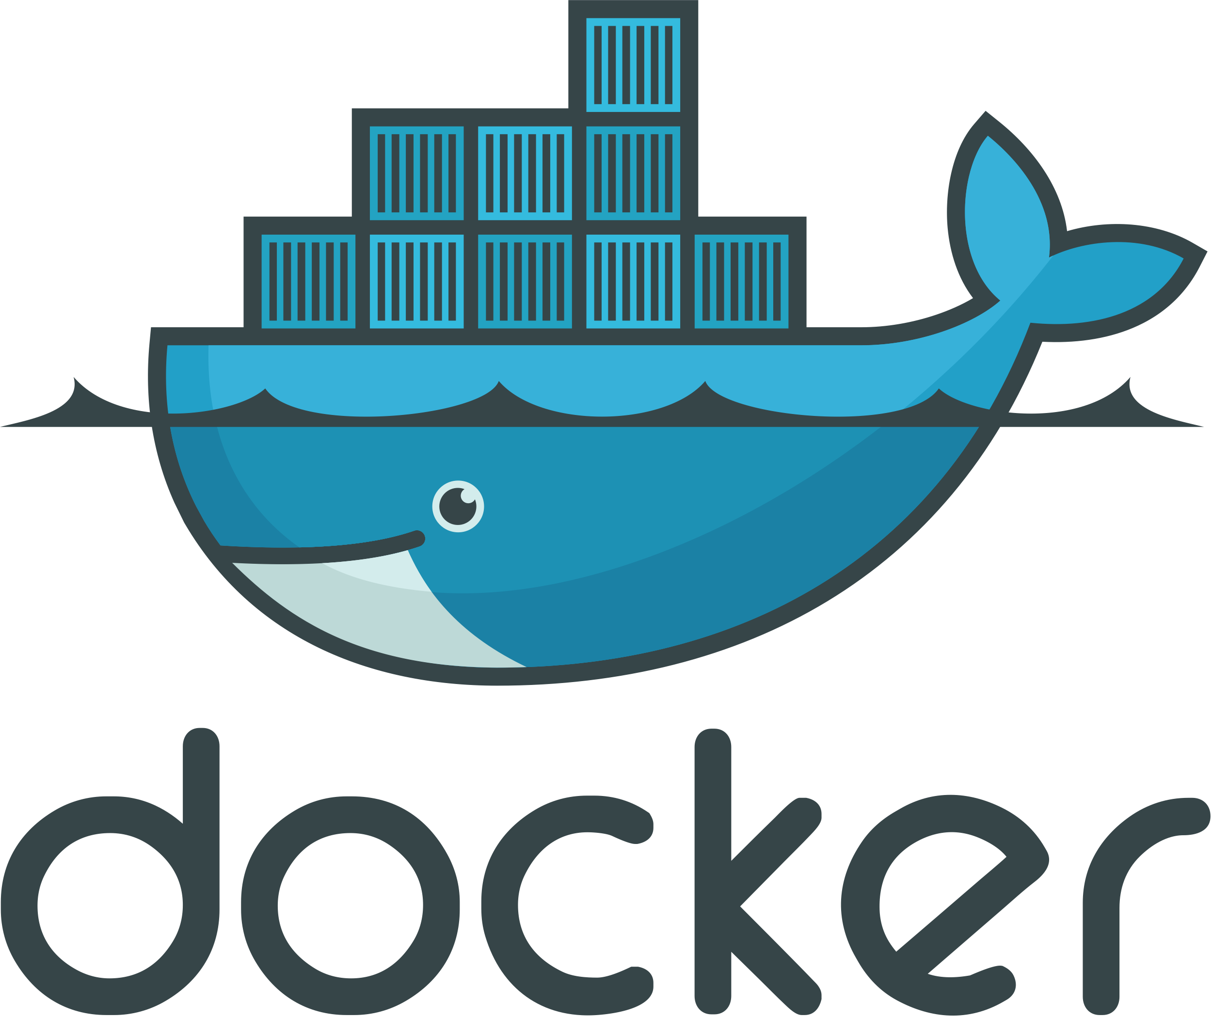
Docker

Slide 3
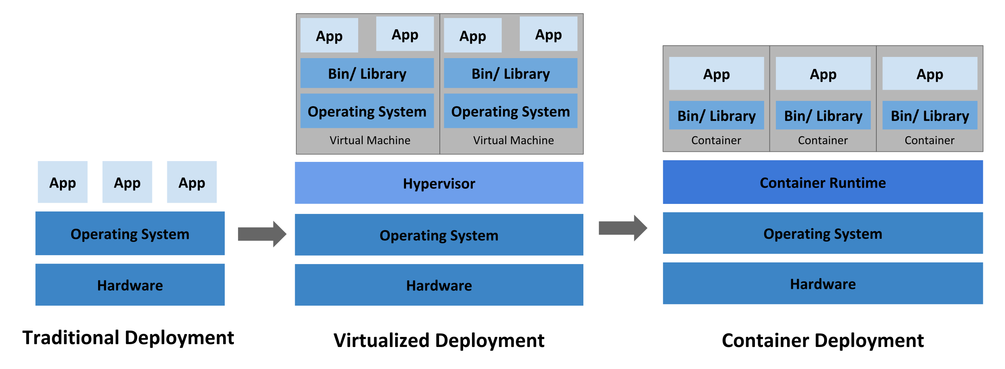
Docker vs VM’s

Slide 4
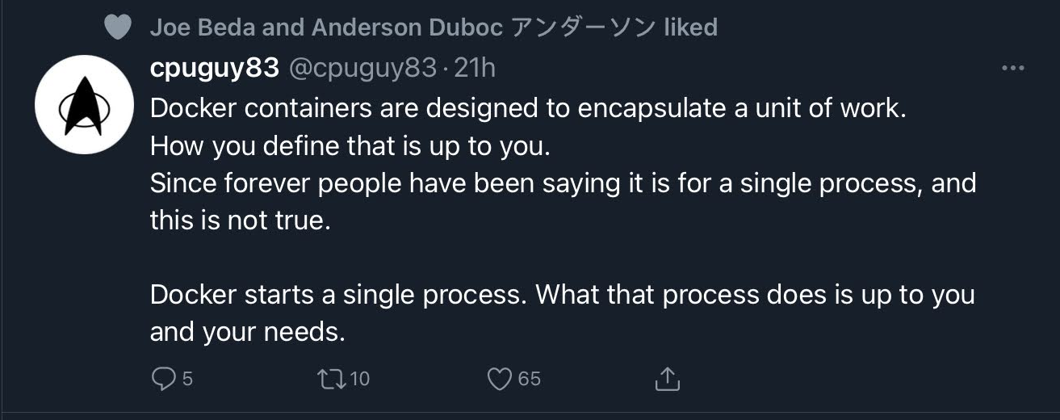
Definition of a Docker container

Slide 5
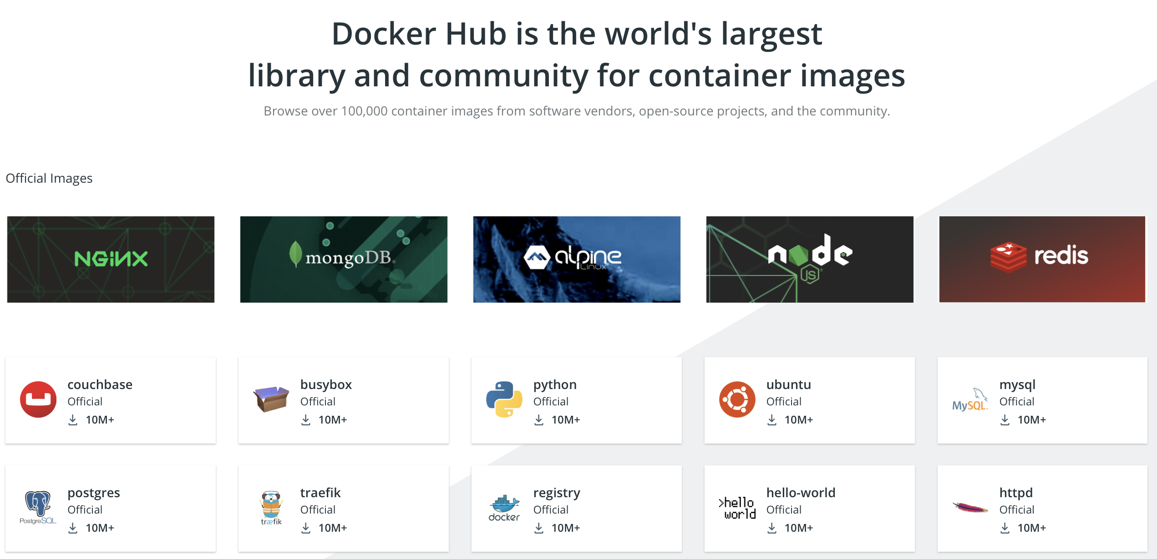
Docker HUB (hub.docker.com)

Slide 6
Docker HUB – Rate limit
The rate limits of 100 container image requests per six hours for anonymous usage, and 200 container image requests per six hours for free Docker accounts are now in effect. Image requests exceeding these limits will be denied until the six hour window elapses.

Slide 7
Dockerfile
Docker can build images automatically by reading the instructions from a Dockerfile.
A Dockerfile is a text document that contains all the commands a user could call on the command line to assemble an image

Slide 8
1. Connect
2. Git
3. Docker
4. Kubernetes
5. CI/CD
6. Misc

